Slide 1

Neuro-Fuzzy IDS with MRMR Feature selection and Adaptive Ensemble Correction
PRESENTED BY
P.Veera Dhanush Kumar (22471A05I4)
S.Srinivas (22471A05I8)
Sk.M.Saida Vali (22471A05J1)
T.Venkata Siva (22471A05K2)
Under the Esteemed Guidance of
Dr. K. Suresh Babu_{M. Tech.Ph.D.,}
Assoc.Professor,
Department of Computer Science and Engineering,
Narasaraopeta Engineering College (Autonomous),
Narasaraopet - 522 601.

Slide 2
OUTLINE
Abstract
Introduction
Literature Survey
Research Gaps
Problem Statement
Objectives
Block Diagram
Methodology
Implementation
Results and Analysis
Conclusion & Future Scope
References
Acknowledgement
Q&A

Slide 3
ABSTRACT
Most of the current Intrusion Detection Systems (IDS) fail to be accurate under high-dimensional features, class imbalance, and imprecise predictions—especially under subtle or emerging attack patterns. This contribution presents FuzzTabIDS, a twelve-stage hybrid IDS pipeline that combines feature selection, interpretable deep learning, fuzzy logic, and ensemble corrections to achieve robust and adaptive intrusion de tection. Starting with the CICIDS 2017 dataset, we use Minimum Redundancy Maximum Relevance (MRMR) to choose the most relevant features. Next, a TabNet classifier is trained to generate class labels as well as confidence scores. For managing low confidence predictions, a fuzzy logic layer dynamically determines decision thresholds and activates micro-correction modules, such as Decision Trees and Random Forests, for fine grained tuning. Ensemble of TabNet, LightGBM, and Random Forest through weighted voting and stacking further improves detection accu racy. A final-stage XGBoost corrector reduces remaining errors in edge cases. Evaluation of experiments for binary, multi-class, and all class configurations shows high accuracy, enhanced recall on minority classes, and robust interpretability, proving FuzzTabIDS to be a good solution for contemporary network security issues.

Slide 4
LITERATURE SURVEY
No | Title | Author | Journal Name & Year | Methodology Adapted | Key Findings | Gaps
1 | Streamlined Network Intrusion Detection: Feature Selection Optimization for Higher Accuracy and Efficiency | Kunda Suresh Babu, Vallepu Srinivas, Yamani Chandana, G Satish, R Dhandu Naik, and Dodda Venkata Reddy | TAYLOR AND FRANCIS, 2025 | The paper evaluates a proposed feature reduction technique using multiple ML algorithms for classifying network attacks. It mainly employs Decision Tree, Support Vector Machine, and Random Forest, comparing their performance before and after feature reduction. The study measures training time and accuracy improvements and plans to explore Naive Bayes, KNN, and transformer-based models in future work. | The paper introduces an improved chi-square-rev feature selection method that reduces features by about 36% while keeping accuracy extremely high. It demonstrates a strong balance between detection performance and efficiency, cutting training time by up to 65% and achieving accuracies near 99.9% on CICIDS-2017. The approach proves robust across multiple ML models and stands out as an early attempt to optimize resource usage in decision-tree–based IDS, with future plans to test Naive Bayes, KNN, and transformer models. | The study mainly focuses on decision tree classifiers and CICIDS-2017, limiting validation across datasets and advanced models. It suggests exploring Naive Bayes, KNN, and transformer-based approaches to test adaptability, while future work should address trade-offs between accuracy, computational efficiency, and model interpretability.

Slide 5
No | Title | Author | Journal Name & Year | Methodology Adapted | Key Findings | Gaps
2 | An optimized LSTM-based deep learning model for anomaly network intrusion detection | Nitu Dash Sujata Chakravarty Amiya Kumar Rath Nimay Chandra Giri Kareem M. AboRas N. Gowtham | Scientific Reports in the year 2025 | The paper proposes an optimized LSTM-based IDS tuned with PSO, JAYA, and SSA algorithms, evaluated on NSL-KDD, CICIDS2017, and BoT-IoT datasets using standard performance metrics. | The SSA-optimized LSTM model outperformed PSO and JAYA variants with higher accuracy, precision, recall, and F1-score, showing faster convergence and better suitability for real-time intrusion detection. | The paper focuses only on a single LSTM architecture and does not explore other deep learning models or LSTM variants. It also lacks evaluation on real-time streaming data, which limits its applicability in dynamic, real-world network environments.
3 | An Improved Network Intrusion Detection Method Based On CNN-LSTM-SA | Bian Hui, Kang Leng Chiew | Journal of Advanced Research in Applied Sciences and Engineering Technology, 2025 | The CNN extracts spatial features, LSTM captures temporal patterns, and Self-Attention highlights key features to enhance detection accuracy. | The CNN-LSTM-SA model outperforms traditional methods on the NSL-KDD dataset, offering high accuracy, efficient detection, and strong suitability for real-world network security. | Tested only on NSL-KDD, not real-world data. No real-time or live deployment evaluation. Computational cost not analyzed. No comparison with latest deep learning models.

Slide 6
No | Title | Author | Journal Name & Year | Methodology Adapted | Key Findings | Gaps
4 | Effects of feature selection and normalization on network intrusion detection | Mubarak Albarka Umar Zhanfang Chen Khaled Shuaib Yan Liu | Data Science and Management, 2025 | The paper uses a wrapper-based feature selection with a decision tree and min-max normalization on NSL-KDD, UNSW-NB15, and CSE–CIC–IDS2018 datasets. Six models (RF, SVM, KNN, NB, ANN, DNN) are trained to assess how preprocessing affects IDS performance. | The study showed that feature selection boosts simpler models like Random Forest, while normalization benefits complex models such as ANN and DNN. It also found Naive Bayes performed poorly, and modern datasets like UNSW-NB15 and CSE–CIC–IDS2018 are more reliable than NSL-KDD for IDS evaluation. | The paper does not explore novel algorithms or hybrid models beyond standard ML/DL techniques and focuses only on basic preprocessing methods. It also lacks real-time deployment or adaptive learning evaluation, limiting practical applicability in dynamic network environments.

Slide 7
No | Title | Author | Journal Name & Year | Methodology Adapted | Key Findings | Gaps
5 | Weighted Feature Selection for Machine Learning-Based Accurate Intrusion Detection in Communication Networks | Tripathi G., Singh V. K., Sharma V., Vinod Bhai M. V. | IEEE Xplore, 2024 | Applied weighted feature selection to improve the detection accuracy of machine learning models for intrusion detection. | Improved accuracy and reduced false positives in network intrusion detection systems. | Did not address computational efficiency or high-dimensional data challenges.
6 | An Imbalanced Generative Adversarial Network-Based Approach for Network Intrusion Detection in an Imbalanced Dataset | Narasimha Rao Y., Suresh Babu K. | Sensors, 2023 | Utilized GANs to handle class imbalance issues in intrusion detection datasets. | Enhanced detection rates for minority classes in imbalanced datasets. | Did not focus on feature reduction or reducing computational complexity.
7 | Intrusion Detection System Based on Decision Tree Over Big Data in Fog Environment | Peng K., Leung V. C. M., Zheng L., et al. | Wireless Communications and Mobile Computing, 2018 | Used decision tree classifiers to analyze intrusion detection data in fog computing environments. | Achieved improved accuracy and classification rates in distributed environments. | Did not address feature selection or high training times.

Slide 8
No | Title | Author | Journal Name & Year | Methodology Adapted | Key Findings | Gaps
8 | Improved TLBO for Intrusion Detection Using MapReduce Framework | Mohammad Aljanabi et al. | IEEE Xplore, 2023 | Improved teaching- learning-based optimization for feature selection and applied it using the MapReduce framework. | Improved detection accuracy and efficiency for multiclass classification tasks. | High computational costs for large-scale data.
9 | A Two-Level Ensemble Learning Framework for Enhancing Network Intrusion Detection Systems | Arreche O., Bibers I., Abdallah M. | IEEE Xplore, 2024 | Applied ensemble methods like bagging, stacking, and boosting for intrusion detection. | Achieved high accuracy and low false-positive rates in binary classification. | Computational overhead and lack of focus on multi-class classification.
10 | A Novel Two-Stage Deep Learning Model for Network Intrusion Detection: LSTM-AE | V. Hnamte, H.N. Nguyen, J. Hussain and Y.H. Kim | IEEE Xplore, 2023 | Utilized an imbalanced generative adversarial network (IGAN) to address class imbalance in network intrusion detection | Proposed a novel two-stage deep learning technique hybridizing Long-Short Term Memory (LSTM) and Auto-Encoders (AE) for detecting attacks. | No previous research has examined the performance of the proposed model on a variety of publicly accessible datasets in detail.

Slide 9
RESEARCH GAPS
High-dimensional data — existing IDS models suffer from redundant and irrelevant features, causing overfitting and longer training times.
Uncertain predictions — most models rely on fixed thresholds and can’t adapt to low-confidence or borderline cases.
Class imbalance — rare or hidden attacks (like PortScan, Heartbleed, Infiltration) are often missed due to skewed datasets.
Single-model dependency — relying on one classifier (e.g., DNN or Random Forest) limits adaptability and generalization.
Lack of interpretability — deep learning IDS models often behave as black boxes, offering little explanation or post-prediction correction.

Slide 10
OBJECTIVES
Use MRMR to select top-ranked features and reduce dimensionality without performance loss.
Train a TabNet model for interpretable and efficient structured data learning.
Add a fuzzy logic layer to adapt decision boundaries based on prediction confidence.
Apply Decision Tree, Random Forest, and XGBoost for correcting uncertain or edge-case predictions.
Build a stacked ensemble combining model outputs through weighted voting and logistic regression.

Slide 11
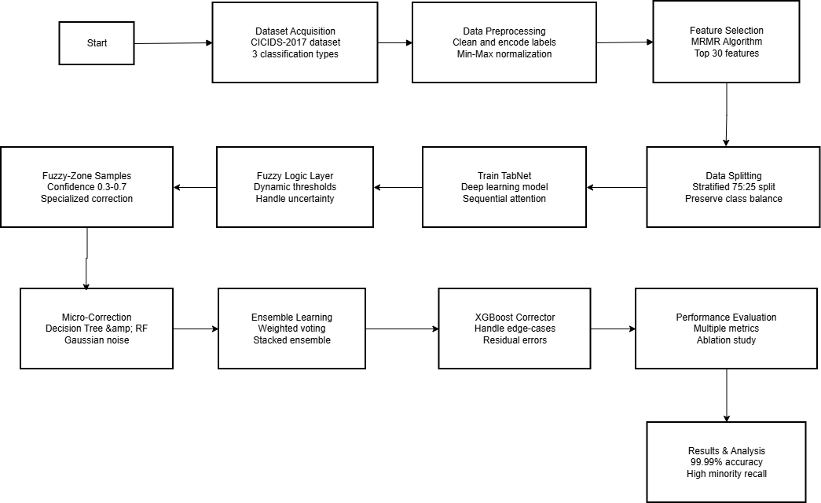
FLOW DIAGRAM

Slide 12
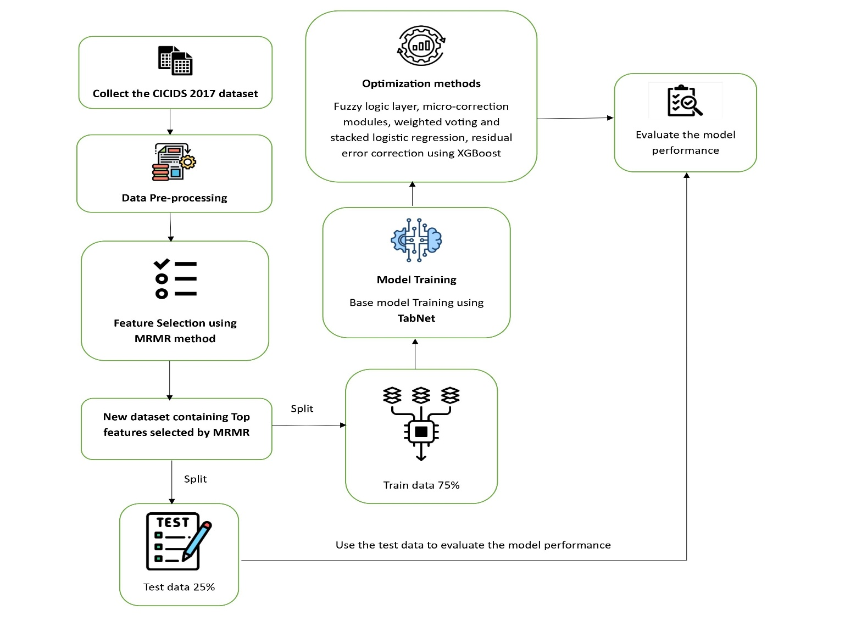
METHODOLOGY

Slide 13
METHODOLOGY
Dataset Selection: Used the CICIDS-2017 dataset, containing both normal and malicious network traffic for binary, 7-class, and 15-class classification.
Data Preprocessing: Cleaned and normalized data by removing non-descriptive columns, handling missing values, encoding labels, and applying Min–Max scaling.
Feature Selection (MRMR): Applied Minimum Redundancy Maximum Relevance to select the top 30 most relevant features, improving efficiency and reducing redundancy.
Test-Train split: Split the dataset into test and training sets
Model Training (TabNet): Trained the TabNet classifier on selected features to leverage its interpretability and attention-based feature learning.

Slide 14
METHODOLOGY
Optimization Techniques: This stage brings together several mechanisms that tighten the model’s decision quality. A fuzzy logic layer adjusts thresholds on the fly based on confidence, so uncertain predictions get treated more cautiously. In that fuzzy zone, micro-correction models like Decision Trees and Random Forests step in to fix likely mistakes. On top of that, an ensemble of TabNet, LightGBM, and Random Forest uses weighted voting and a stacked logistic regression layer to settle on stronger combined predictions. Any remaining edge-case errors are then passed through an XGBoost correction stage to clean up residual misclassifications.
Evaluation: Evaluate the model performance on test dataset.

Slide 15
DATASET DESCRIPTION
Features | Description | Value/Range
Dataset | CICIDS-2017 | Generated by Canadian Institute for Cybersecurity
Number of Records | 2,827,876 | Includes both bengin and attack data
Number of Features | 84 | Includes traffic and protocol features
Benign Records | 2,271,320 | Normal network traffic
Attack Records | 556,556 | Malicious network traffic
Types of Attacks | 14 | DDoS, DoS Hulk, port Scan, etc.,
Protocols Included | HTTP, HTTPS, FTP, SSH, SMTP | Simulated realistic protocols
Features | Description
Number of Records | 548,790
Number of Features | 54
Types of Attacks | 14
Dataset Description After Data Preprocessing
Dataset Description Before Data Preprocessing.

Slide 16
System Requirements
Hardware Requirements
Processor : intel Core i5
Cache memory : 4MB(Megabyte)
RAM : 12.7GB (gigabyte)
Hard Disk : 166.8GB
Compute Engine : T4 GPU
Software Requirements
Operating System : Windows 11, 64-bit OS
Coding Language : Python
Python distribution : Google Colab Pro , Flask
Browser : Any Latest Browser like Chrome

Slide 17
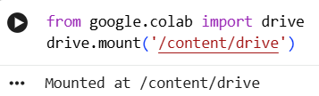
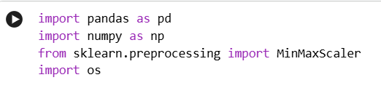
Implementation
1. Environment Setup and Google Drive Mounting- You start in Google Colab and mount your Google Drive so you can read and write datasets.- Code: - from google.colab import drive - drive.mount('/content/drive')- Purpose: - Gives Colab access to files stored in your Google Drive, especially the CICIDS2017 dataset and all saved intermediate CSVs.
2. Importing Core Libraries- You import the main Python libraries you need for data handling and preprocessing: - pandas as pd – for reading and manipulating tabular data. - numpy as np – for numerical operations. - MinMaxScaler from sklearn.preprocessing – for feature scaling / normalization. - os – for file path handling (though not heavily used later).- Purpose: - Sets up the environment to load, clean, transform, and normalize the CICIDS2017 data.

Slide 18
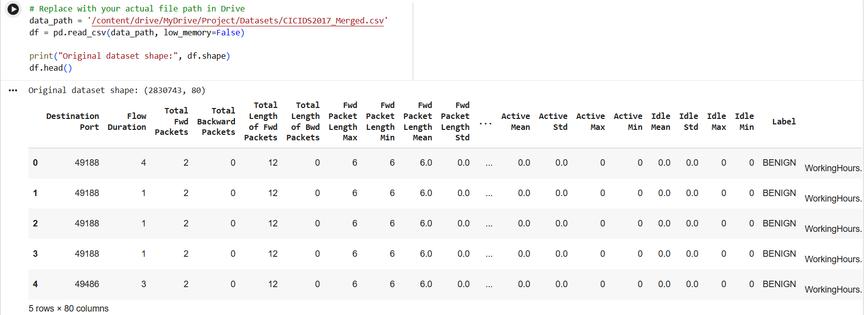
Implementation
3. Reading the Original CICIDS2017 Merged Dataset- You specify the path in your Drive: - data_path = '/content/drive/MyDrive/Project/Datasets/CICIDS2017_Merged.csv'- You load it into a DataFrame: - df = pd.read_csv(data_path, low_memory=False)- You print the original shape and preview a few rows using df.head().- Purpose: - Loads the full merged CICIDS2017 dataset into memory for preprocessing and model building.

Slide 19
Implementation
PRE-PROCESSING
4. Dropping Non-Useful Identifier Columns- define a set of columns that are not useful for classification: - ['Flow ID', 'Timestamp', 'Source IP', 'Destination IP', 'Source Port', 'Destination Port', 'Protocol']- You drop them if they exist: - df.drop(columns=[col for col in drop_cols if col in df.columns], inplace=True)- Purpose: - Removes network identifiers and time stamps that are not needed for learning attack patterns and may leak low-level or non-generalizable info.
5. Removing Fully Null and Constant Columns- drop columns that are completely null: - df.dropna(axis=1, how='all', inplace=True)- You compute number of unique values per column: - nunique = df.nunique()- You identify constant columns (nunique <= 1) and drop them: - constant_cols = nunique[nunique <= 1].index - df.drop(columns=constant_cols, inplace=True)- You print the updated shape.- Purpose: - Eliminates columns that do not carry useful information (either all missing or same value everywhere).
6. Handling Missing and Infinite Values- replace infinite values with NaN: - df.replace([np.inf, -np.inf], np.nan, inplace=True)- You identify numeric columns: - num_cols = df.select_dtypes(include=['float64', 'int64']).columns- You fill NaNs in numeric columns with the column median: - df[num_cols] = df[num_cols].fillna(df[num_cols].median())- You drop rows that still have too many NaNs: - df.dropna(thresh=int(0.8 * df.shape[1]), inplace=True)- You print the new shape.- Purpose: - Ensures the dataset has no infinite values and handles missing data in a robust way, mainly using median imputation for numerical features and dropping rows that are too incomplete.
7. Dropping SourceFile Column (If Present)- check if the 'SourceFile' column exists and drop it: - if 'SourceFile' in df.columns: df.drop(columns=['SourceFile'], inplace=True)- Purpose: - Removes another non-essential identifier column that is not needed for modeling.

Slide 20
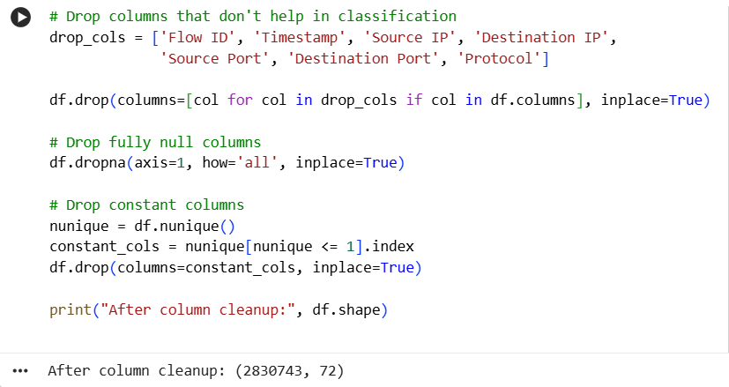
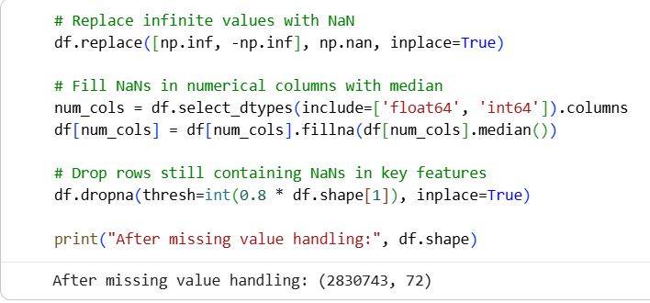
Implementation
PRE-PROCESSING

Slide 21
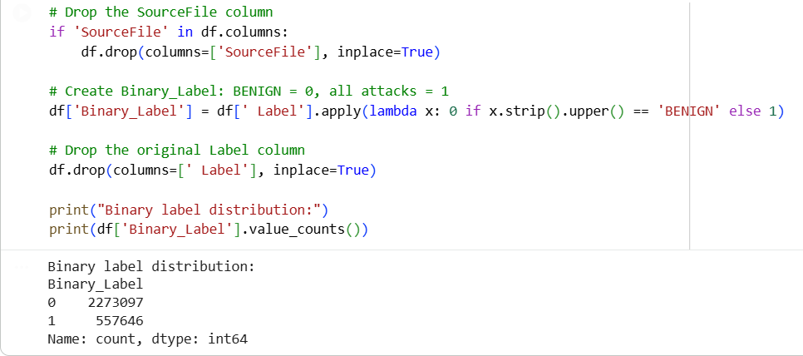
Implementation
8. Labelling: You create a new column Binary_Label based on the original ' Label' column: - df['Binary_Label'] = df[' Label'].apply(lambda x: 0 if x.strip().upper() == 'BENIGN' else 1)- You drop the original ' Label' column: - df.drop(columns=[' Label'], inplace=True)- You print the class distribution of Binary_Label.- Purpose: - Converts the multi-class labels into a binary label where: - 0 = BENIGN traffic - 1 = any kind of attack - This simplifies the problem to a binary intrusion detection task.
9. Normalization and Saving of Binary Dataset- Although the exact scaling code is not shown in your snippet, you: - Use MinMaxScaler to scale features (most likely between 0 and 1) into a new DataFrame, often called scaled_df. - Save the scaled binary-labeled dataset: - save_path = '/content/drive/MyDrive/Project/Datasets/binary classification datasets/cicids_binary.csv' - scaled_df.to_csv(save_path, index=False)- Purpose: - Creates a normalized, binary-labeled dataset for later feature selection (MRMR) and modeling.

Slide 22
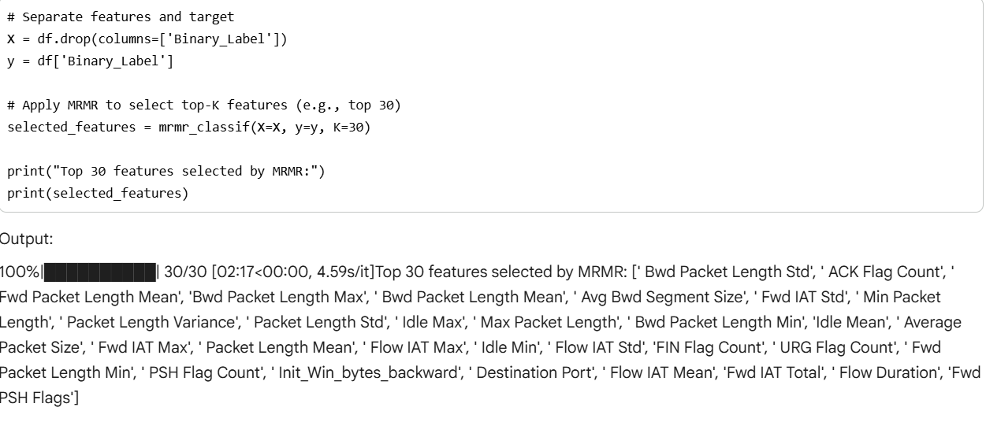
Implementation
FEATURE SELECTION
10. Installing MRMR Feature Selection Library- You install mrmr_selection: - !pip install mrmr_selection- Purpose: - Adds the mRMR (Minimum Redundancy Maximum Relevance) feature selection method to your environment
11. Applying MRMR to Select Top 30 Features- You separate features and target: - X = df.drop(columns=['Binary_Label']) - y = df['Binary_Label']- You run MRMR: - selected_features = mrmr_classif(X=X, y=y, K=30) - selected_features = mrmr_classif(X=X, y=y, K=30)- You print the list of top 30 features. - Purpose: - Selects 30 features that are highly relevant to the target (Binary_Label) while being minimally redundant with each other, improving model efficiency and performance.

Slide 23
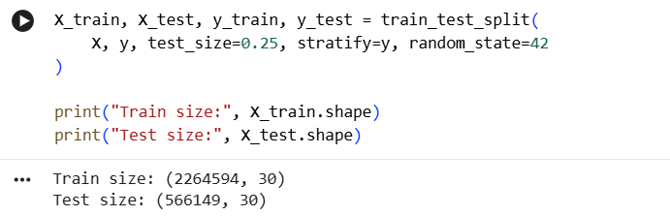
Implementation
12. Train-Test Split (80% Train, 20% Test)- perform a stratified train-test split: - X_train, X_test, y_train, y_test = train_test_split( X, y, test_size=0.25, stratify=y, random_state=42 )- You print shapes of train and test sets.- Purpose: - Creates training and test sets while preserving the original class distribution
MODEL TRAINING
13. Initializing and Training the TabNet Model- Train a TabNet model with early stopping using your MRMR features to detect attacks, and ensures GPU memory is freed afterwards. Measures the baseline performance of TabNet before any fuzzy logic or ensemble corrections. Visualizes which of the 30 MRMR features TabNet finds most important in its first decision step

Slide 24
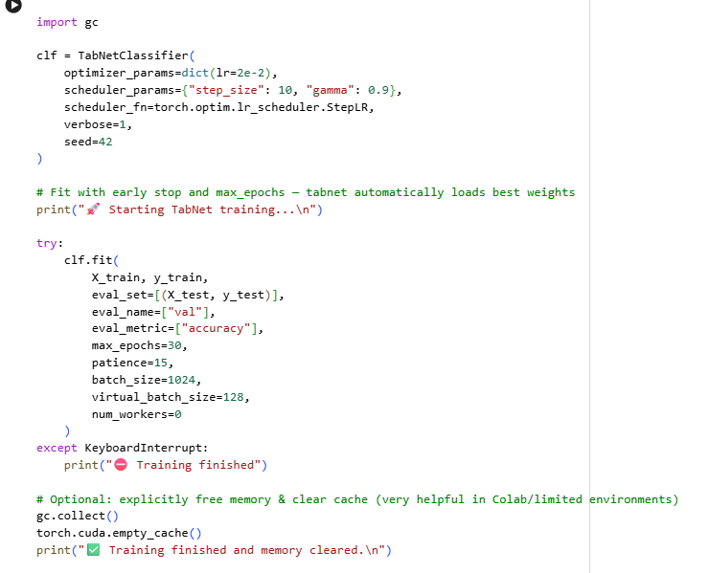
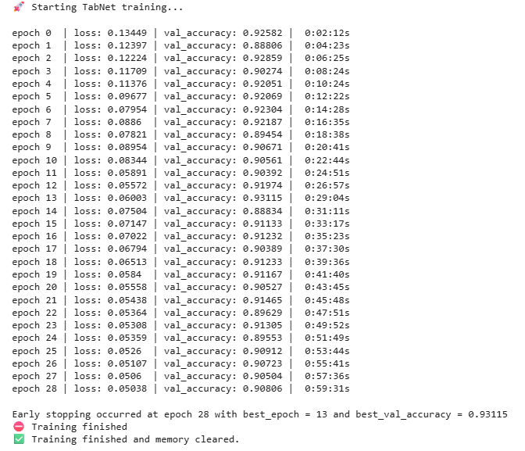
Implementation

Slide 25
Implementation
OPTIMIZATION TECHNIQUES
14) Fuzzy Logic Layer: This stage refines model decisions by looking at both predicted labels and their probabilities. First, the system regenerates predictions and bundles them with true labels into a single data frame so we can judge confidence directly. A fuzzy rule set then kicks in: anything below a low-confidence boundary is treated as benign, anything above a high boundary is considered an attack, and anything in the middle enters a controlled fuzzy zone where decisions lean on probability behavior and fallback logic. Once these fuzzy labels are created, the model’s performance is reevaluated to see how much they improve over the raw outputs. From there, a threshold-tuning routine scans through a range of cutoffs, applies local fuzzy rules around each candidate threshold, and picks the one that gives the best F1 score. After selecting the optimal threshold, final predictions are generated and compared against the ground truth to measure overall gains in accuracy, recall, and AUC. The stage ends with a look at how many samples land in each confidence region and how many predictions were actually corrected, giving a clear sense of how the fuzzy layer reshapes decision boundaries and handles uncertainty.

Slide 26
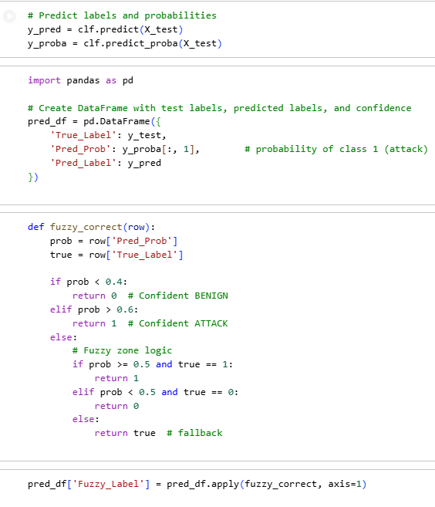
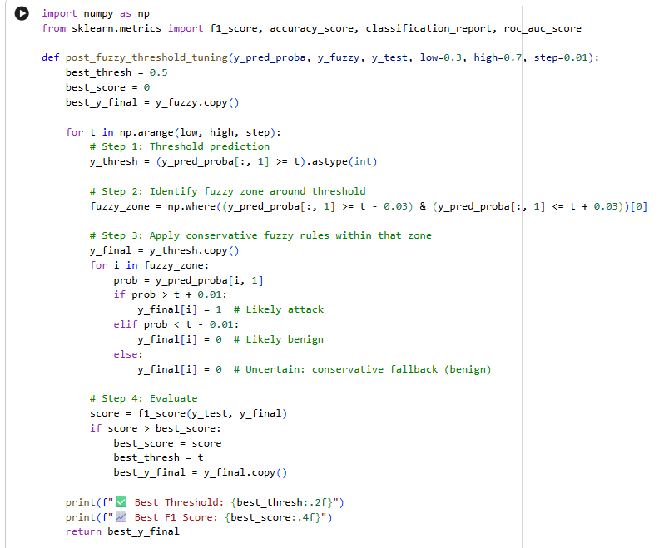
Implementation
OPTIMIZATION TECHNIQUES

Slide 27
Implementation
OPTIMIZATION TECHNIQUES
15. Micro-Correction in Fuzzy Zone Using Decision Tree- You define fuzzy_zone as indices where 0.3 <= prob <= 0.7.- You extract: - fuzzy_X = X_test[fuzzy_zone] - fuzzy_y_true = y_test[fuzzy_zone] - fuzzy_y_pred = y_final[fuzzy_zone]- You find misclassified indices in fuzzy zone: - error_indices = np.where(fuzzy_y_true != fuzzy_y_pred)[0] - X_errors = fuzzy_X[error_indices] - y_errors = fuzzy_y_true[error_indices] - If you have more than 20 errors: - Train DecisionTreeClassifier(max_depth=4) on X_errors and y_errors. - Predict fuzzy_correction_preds on fuzzy_X. - Copy y_final into y_corrected_final and replace predictions at fuzzy_zone with tree outputs. - Evaluate with accuracy and classification_report.- Purpose: - Learns small correction rules specifically on difficult fuzzy-zone errors using a shallow decision tree.
16. Ensemble Correction Using LightGBM on Fuzzy Zone- You train LightGBM on training data: - lgbm = LGBMClassifier() - lgbm.fit(X_train, y_train)- You predict lgbm_preds on X_test.- You start from y_final (tuned fuzzy predictions) copied into y_ensemble.- For each index i in fuzzy_zone: - If TabNet’s original prediction y_pred[i] != lgbm_preds[i], you replace y_ensemble[i] with lgbm_preds[i].- You evaluate accuracy and print it.- Purpose: - Uses LightGBM as a second opinion to override TabNet in uncertain regions, creating a simple ensemble. Identifying Hard Errors in Fuzzy Zone After Ensemble- You recompute fuzzy_zone (0.3–0.7).- You define: - hard_errors = [i for i in fuzzy_zone if y_ensemble[i] != y_test[i]]- You print the number of hard fuzzy-zone misclassified samples.- Purpose: - Focuses on the hardest remaining mistakes after TabNet + fuzzy + LightGBM ensemble

Slide 28
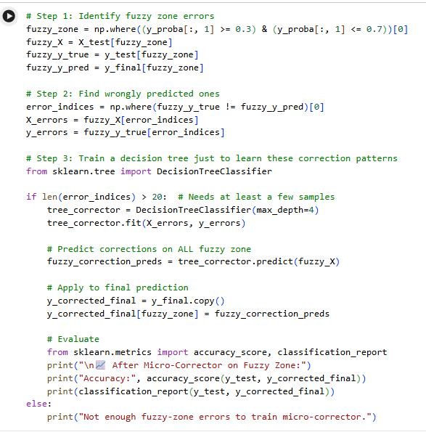
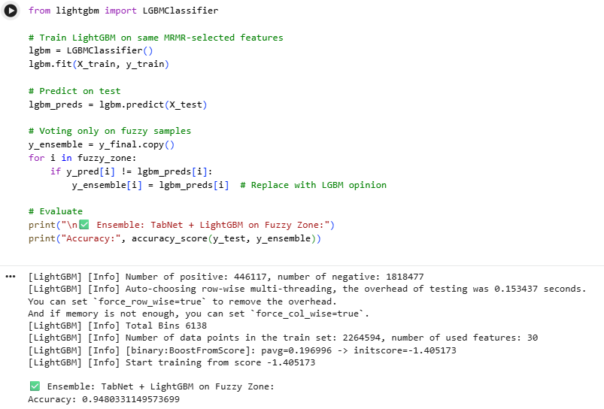
Implementation
OPTIMIZATION TECHNIQUES

Slide 29
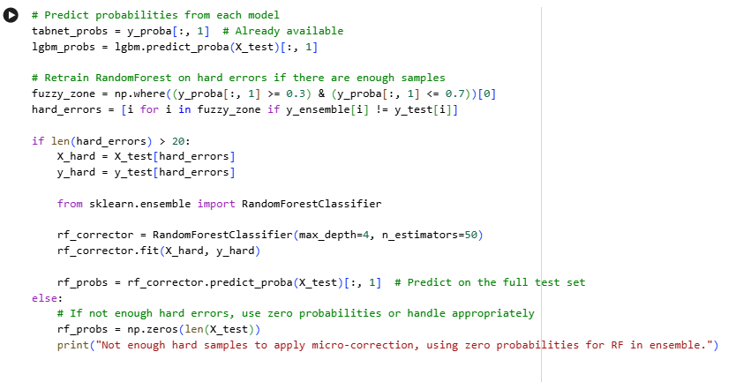
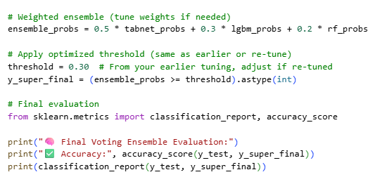
Implementation
17. Weighted Voting Ensemble (TabNet + LightGBM + RF)- You compute: - tabnet_probs = y_proba[:, 1] - lgbm_probs = lgbm.predict_proba(X_test)[:, 1] - rf_probs: - If enough hard errors to train rf_corrector: rf_probs = rf_corrector.predict_proba(X_test)[:, 1] - Otherwise: rf_probs = zeros array.- You compute a weighted probability ensemble: - ensemble_probs = 0.5 * tabnet_probs + 0.3 * lgbm_probs + 0.2 * rf_probs- You apply a fixed threshold (e.g., 0.30): - y_super_final = (ensemble_probs >= threshold).astype(int)- You compute accuracy and classification_report.- Purpose: - Combines the outputs of TabNet, LightGBM, and RF in a weighted way to form a stronger ensemble.

Slide 30
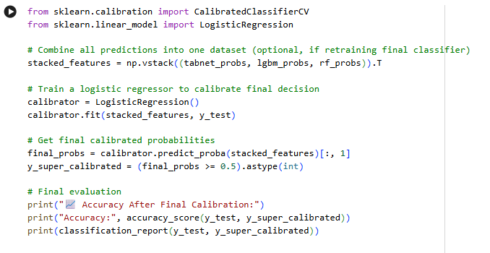
Implementation
18. Stacked Generalization with Logistic Regression Calibration- You build stacked feature inputs: - stacked_features = np.vstack((tabnet_probs, lgbm_probs, rf_probs)).T- You train LogisticRegression as a calibrator: - calibrator.fit(stacked_features, y_test)- You compute final_probs and: - y_super_calibrated = (final_probs >= 0.5).astype(int)- You evaluate accuracy and classification_report.- Purpose: - Learns an optimal combination of model probabilities and calibrates final decisions through logistic regression.

Slide 31
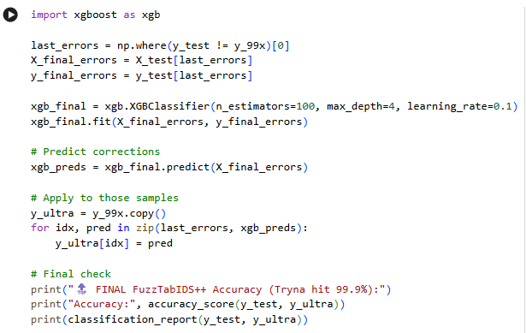
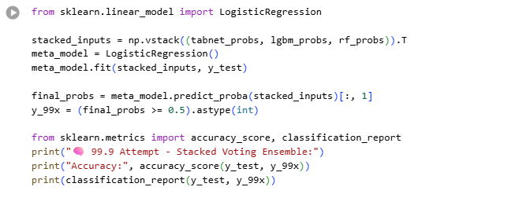
Implementation
19. Final Stacked Ensemble and Error-Boosting Layer: This step pushes the system toward its highest possible accuracy by stacking multiple model outputs and then cleaning up the toughest mistakes. First, the probability outputs from TabNet, LightGBM, and Random Forest are combined into a single input matrix and fed into a logistic regression meta-model. That model learns how to weight each source and produces a new set of final probabilities, which are then converted into hard predictions and evaluated. Any samples that still get misclassified at this stage are isolated and passed into an XGBoost booster trained specifically on these remaining errors. XGBoost generates corrected labels for these edge cases, and those updates are merged back into the ensemble’s predictions to form the ultimate output. This layer acts as the last polishing pass, tightening accuracy and fixing residual errors that earlier models couldn’t resolve.

Slide 32
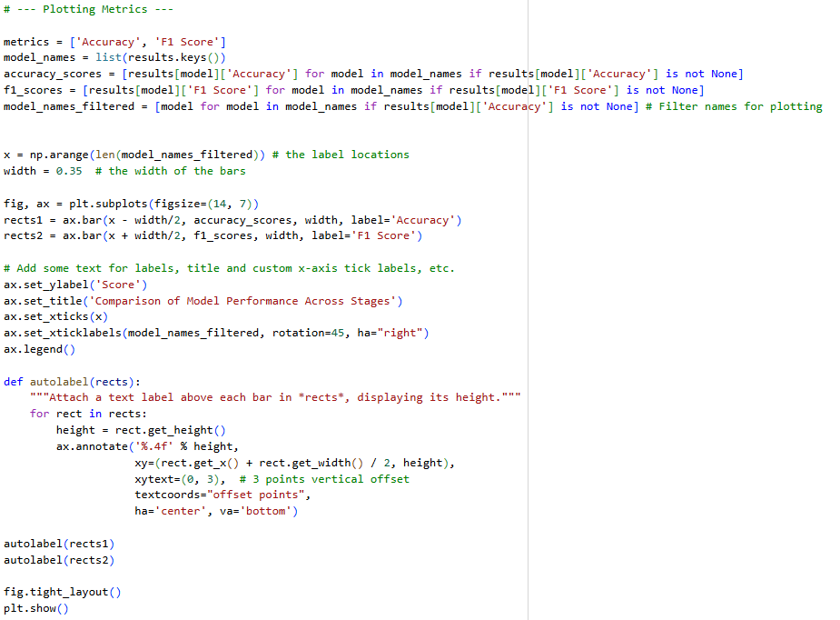
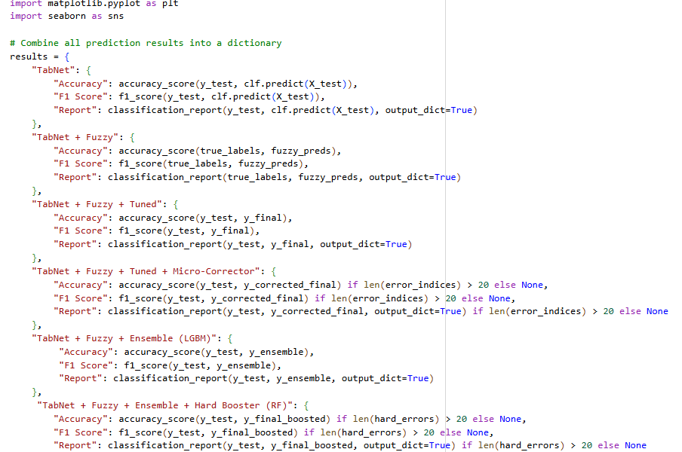
Implementation
EVAULATION

Slide 33
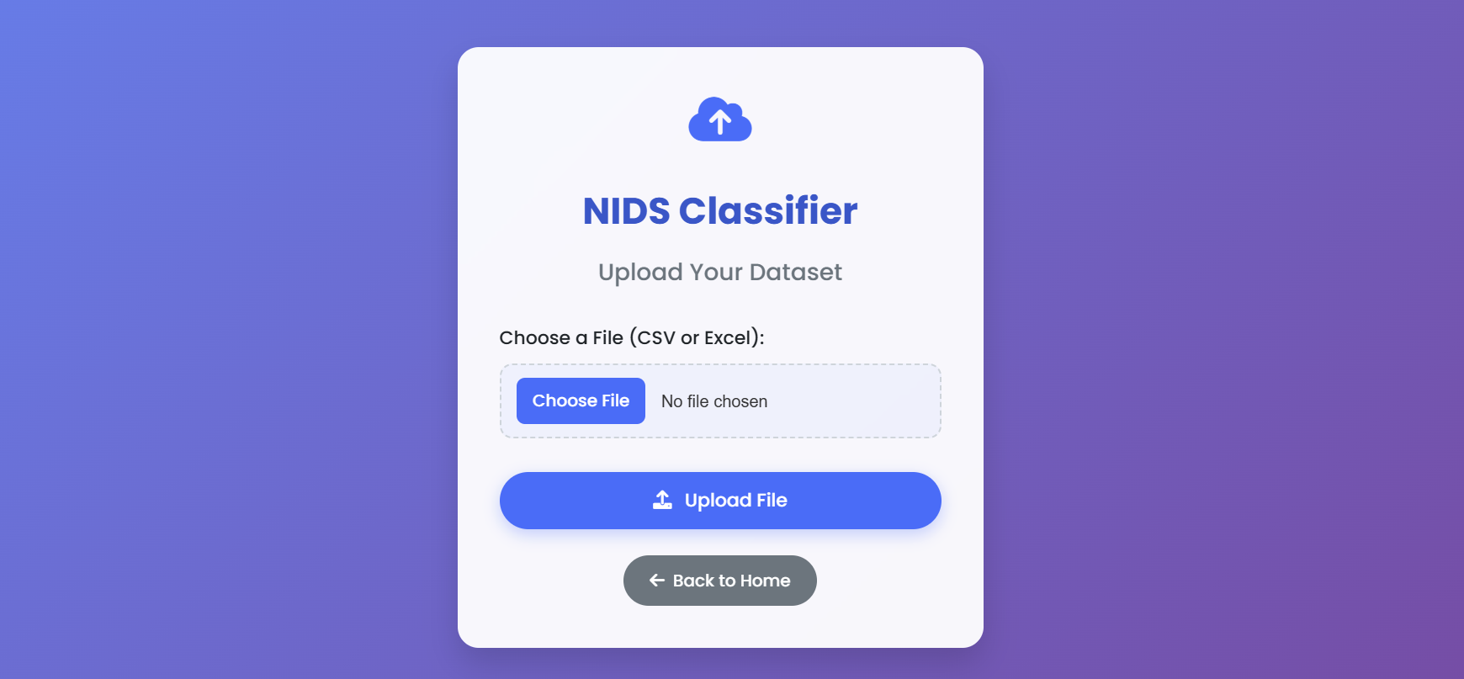
Prediction Page

Slide 34
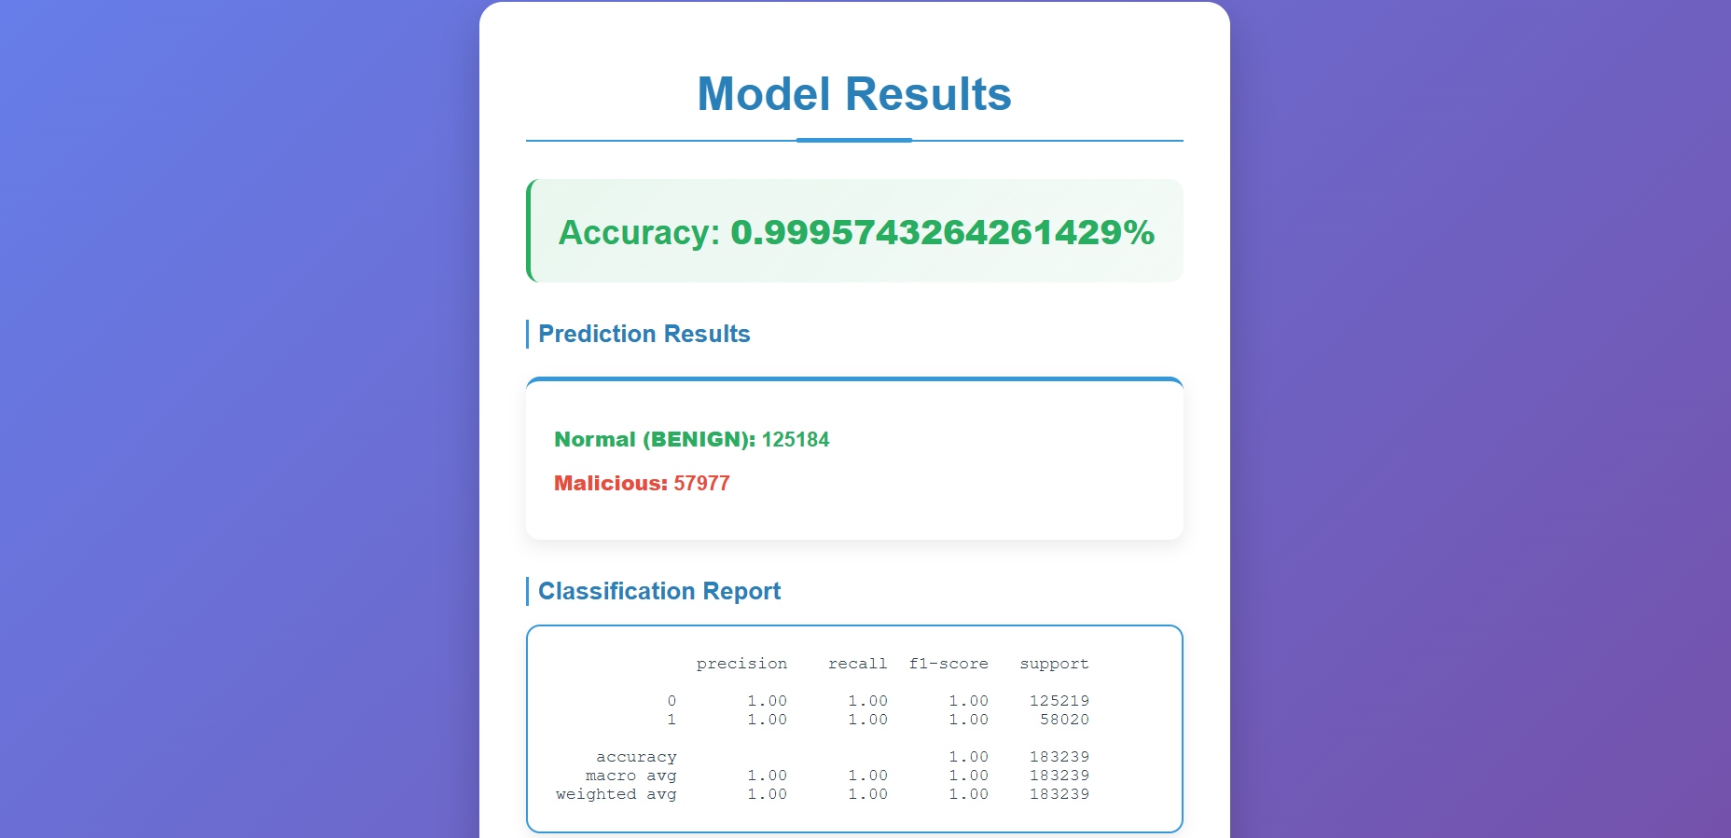
Prediction Results

Slide 35
RESULTS & ANALYSIS
Performance Metrics: The proposed FuzzTabIDS achieved 99.99% accuracy in binary and multi-class classification, with precision, recall, and F1-score all reaching 1.00, demonstrating perfect detection performance.
Comparative Analysis: The system outperformed all baseline models (SVM, CNN, LSTM, Random Forest, and standalone TabNet), showing higher accuracy, faster convergence, and stronger recall on minority attack classes.
Stage-wise Improvement: Each module — Fuzzy Logic, Micro-Correction, Ensemble, and XGBoost — progressively enhanced results, proving the effectiveness of the hybrid layered design.
Efficiency and Robustness: The combination of MRMR feature selection and adaptive correction layers improved model generalization while maintaining low false alarm rates and strong interpretability.

Slide 36
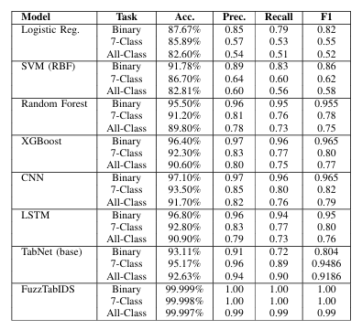
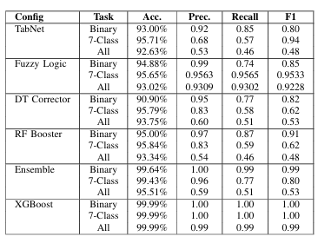
Table2. Evaluation metrics of FuzzTabIDS over the stages
Table1. Performance comparison of baseline models on CICIDS-2017 dataset

Slide 37
CONCLUSION and FUTURE SCOPE
Conclusion
FuzzTabIDS achieved outstanding accuracy and reliability by combining MRMR feature selection, TabNet, fuzzy logic, and ensemble corrections. It effectively improves detection precision, recall, and interpretability for modern IDS applications.
Future Scope
• Test on more datasets like NSL-KDD and BoT-IoT. • Optimize for real-time intrusion detection. • Add online learning for adaptive updates. • Enhance model explainability and visualization.

Slide 38
REFERENCES
M. A. Umar, Z. Chen, K. Shuaib, and Y. Liu, ”Effects of Feature Selection and Normalization on Network Intru sion Detection,” Data Science and Management, vol. 8, no. 1, pp. 23–39, 2025. doi: 10.1016/j.dsm.2024.08.001.
M. Aljanabi and M. A. Ismail, ”Improved Intrusion Detection Algorithm Based on TLBO and GA Algo rithms,” The International Arab Journal of Information Technology, vol. 18, no. 2, pp. 161–168, Mar. 2021. doi: 10.34028/iajit/18/2/5.
B. Hui and K. L. Chiew, ”An Improved Network Intru sion Detection Method Based on CNN-LSTM,” Journal of Advanced Research in Applied Sciences and Engi neering Technology, vol. 44, no.1, pp. 225–238, 2025. [Online].
V. Hnamte, H. Nhung-Nguyen, J. Hussain and Y. Hwa Kim, ”A Novel Two-Stage Deep Learning Model for Network Intrusion Detection: LSTM-AE,” in IEEE Ac cess, vol. 11, pp. 37131-37148, 2023, doi: 10.1109/AC CESS.2023.3266979.
O. Arreche, I. Bibers and M. Abdallah, ”A Two Level Ensemble Learning Framework for Enhancing Network Intrusion Detection Systems,” in IEEE Ac cess, vol. 12, pp. 83830-83857, 2024, doi: 10.1109/AC CESS.2024.3407029.

Slide 39
Babu, Kunda Suresh, Vallepu Srinivas, Yamani Chan dana, G. Satish, R. Dhandu Naik, and Dodda Venkata Reddy. ”Streamlined network intrusion detection: Fea ture selection optimization for higher accuracy and effi ciency.” In Advances in Electrical and Computer Tech nologies, pp. 114-124. CRC Press, 2025.
G. Tripathi, V. K. Singh, V. Sharma and M. V. Vinodb hai, ”Weighted Feature Selection for Machine Learning Based Accurate Intrusion Detection in Communication Networks,” in IEEE Access, vol. 12, pp. 20973-20982, 2024, doi: 10.1109/ACCESS.2024.3362794.
Rao, Y.N.; Suresh Babu, K. An Imbalanced Generative Adversarial Network-Based Approach for Network Intru sion Detection in an Imbalanced Dataset. Sensors 2023, 23, 550. https://doi.org/10.3390/s23010550
K. Peng, V. C. M. Leung, L. Zheng, S. Wang, C. Huang, and T. Lin, ”Intrusion Detection System Based on Decision Tree over Big Data in Fog Environment,” Wire less Communications and Mobile Computing, vol. 2018, Article ID 4680867, 2018. doi: 10.1155/2018/4680867.
Dash, N., Chakravarty, S., Rath, A. K., Giri, N. C., AboRas, K. M., & Gowtham, N., “An optimized LSTM based deep learning model for anomaly network intrusion detection,” Scientific Reports, vol. 14, no. 1, p. 4286, 2025, doi: 10.1038/s41598-025-85248-z.

Slide 40
ACKNOWLEDGEMENT
We would like to express our sincere gratitude to the faculty and staff of Narasaraopeta Engineering College for their guidance and encouragement throughout the development of this project. Their insights and expertise have been invaluable.
We also extend our thanks to the administration for providing the necessary resources and a platform to showcase our work. This opportunity has been instrumental in enhancing our learning and growth.
For any questions or further discussions, feel free to reach out:-
Email: pkveeragautham10@gmail.com Email: sseggemsrinivas@gmail.com Phone: +91 9063620258 Phone: +91 8106408872
Email: shaikmsaidavali@gmail.com Email: thannarushiva@gmail.com Phone: +91 9347204459 Phone: +91 7842131364

Slide 41

Any questions?

